Slide 1
Spring Boot Series – Day 9
Topic: Spring Boot Security – JWT Authentication
&
Role-Based Access
@CodeByHaindavi | #SpringWithMe

Slide 2
Why Authentication Matters in Backend APIs
✔️ When building APIs that serve user-specific data, access control isn't optional — it's the first line of defense. ✔️ Authentication helps the system confirm who is making the request before allowing any action to proceed. ✔️ Without proper authentication, even a perfectly coded API can become a doorway for misuse, data leaks, or unauthorized access. ✔️ In any real-world system, security must be baked in — not patched later — especially when APIs are exposed to external clients.
@CodeByHaindavi | #SpringWithMe

Slide 3
What is JWT (JSON Web Token)?
✔️ JWT, or JSON Web Token, is a way to securely send user identity between the client and server — without storing anything on the server. ✔️ The token is made up of three parts: a header (to describe the token), a payload (which includes user details and roles), and a signature (which proves it wasn’t tampered with). ✔️ After a successful login, the server generates this token and sends it back to the client. From that point on, the client includes the token in every request. ✔️ Since the token carries all the necessary identity information, the server doesn’t need to maintain a session — which makes JWT perfect for scalable, stateless REST APIs.
@CodeByHaindavi | #SpringWithMe

Slide 4
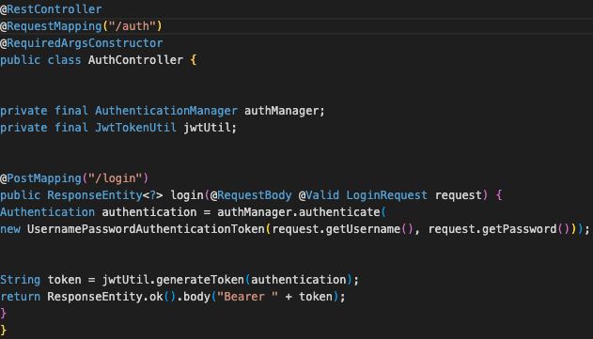
How JWT Authentication Works
✔️ When a user logs in, the server verifies the credentials and returns a signed JWT containing user identity and roles. ✔️ The client stores this token (usually in localStorage or memory) and includes it in the Authorization header for every protected request. ✔️ On the backend, a security filter intercepts incoming requests, validates the token, loads the user context, and allows access only if the token is valid and not expired.
@CodeByHaindavi | #SpringWithMe

Slide 5
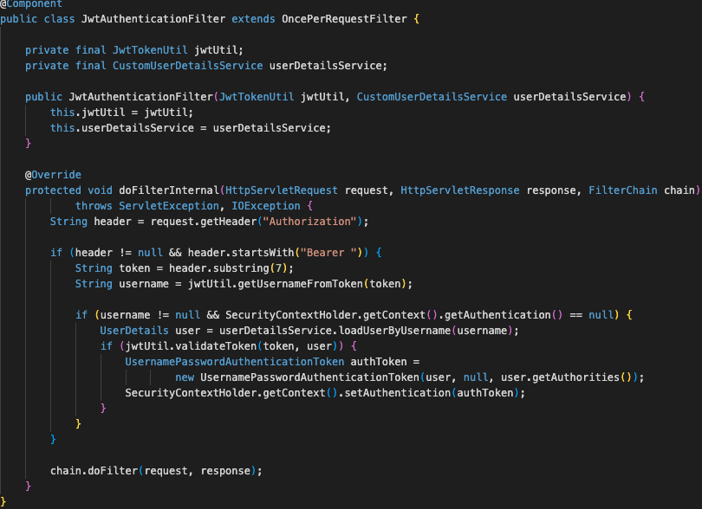
Implementing JWT in Spring Boot
✔️ After login, a JWT is generated by a token utility class and returned to the client — this token contains the user’s identity and roles. ✔️ For every secured request, the authentication filter reads the token from the header, validates it, and sets the user context. ✔️ Controllers and services don’t worry about credentials — they simply rely on the token’s claims to make authorization decisions.
@CodeByHaindavi | #SpringWithMe

Slide 6
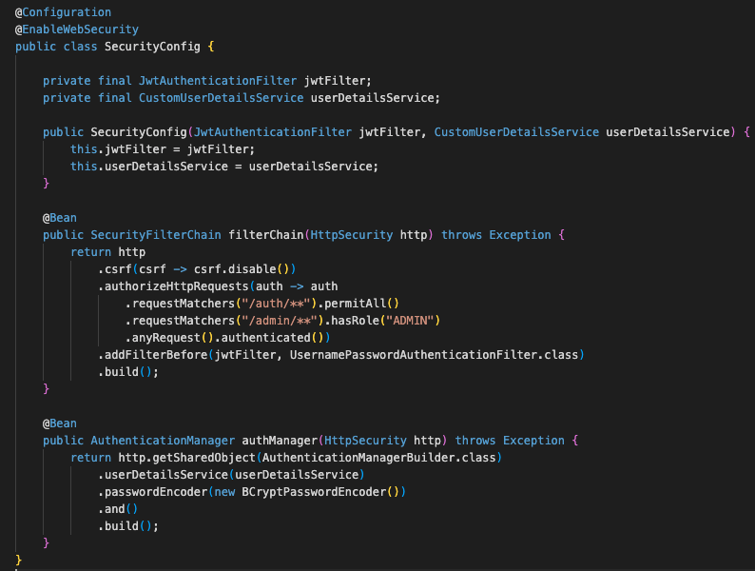
Role-Based Access Control (RBAC)
✔️ Role-Based Access Control (RBAC) limits what authenticated users can access based on roles like ADMIN or CUSTOMER, helping protect sensitive operations. ✔️ Spring Security provides annotations like hasRole() and @PreAuthorize to enforce these restrictions directly on endpoints, keeping role separation clean and configurable.
@CodeByHaindavi | #SpringWithMe

Slide 7
Handling 401 and 403 Errors
✔️ The client first logs in using valid credentials, and the backend responds with a signed JWT containing the user's identity. ✔️ This token is then stored on the client side (like localStorage) and sent along with every protected API call via the Authorization header. ✔️ On the backend, a security filter verifies the token’s signature and validity before allowing the request to proceed. ✔️ The attached screenshots walk through this entire process — from login to accessing secured endpoints — showing how token-based access works in action.
@CodeByHaindavi | #SpringWithMe

Slide 8
📌 Hands-On Tip
✔️ Never hardcode JWT secrets inside your codebase — use environment variables or secure config management to store them safely. ✔️ Always verify both the token’s expiration and digital signature before trusting its claims — skipping this opens doors to spoofing. ✔️ Enforce HTTPS in production environments so tokens can't be sniffed or intercepted during transmission. ✔️ Log all failed token validations — it helps you catch expired tokens, malformed headers, or even attack attempts in real time. ✔️ Set a sensible token expiry — long enough for user convenience, but short enough to limit exposure if stolen. ✔️ Rotate secrets periodically and implement token revocation strategies (like blacklists) for added control in sensitive systems.
@CodeByHaindavi | #SpringWithMe

Slide 9
💼 Interview Insight
How does JWT-based authentication differ from session-based authentication?
• JWT is stateless — the server doesn’t store any session data; all user info is in the token itself.
• In session-based auth, the server holds user state, and each request must match an active session stored on the server.
How do you ensure a JWT is secure and trustworthy?
• Validate the token’s digital signature using a secret or public key, and always check its expiration time.
• Never trust token claims blindly — always verify before use, and transmit tokens only over HTTPS.
What’s the difference between 401 and 403 in JWT-based APIs? • 401 Unauthorized: the request lacks a valid token — user is not authenticated.
• 403 Forbidden: token is valid, but the user doesn’t have the necessary permissions to access the resource.
@CodeByHaindavi | #SpringWithMe

Slide 10
📌 Recap – Day 9
✔️ JWTs allow stateless authentication by securely embedding user identity and roles into a signed token, removing the need for server-side sessions. ✔️ The token flow is simple but powerful: user logs in → receives JWT → attaches it to Authorization header → backend verifies and grants access. ✔️ Custom filters, token utilities, and exception handlers work together to validate tokens, load user context, and return clean 401/403 errors. ✔️ Role-Based Access Control (RBAC) ensures that even with a valid token, access to specific endpoints is allowed only if the user's role matches. ✔️ Security best practices matter — never hardcode secrets, enforce HTTPS, set expiry, validate tokens thoroughly, and always log failures safely.
👉 Coming up next: Securing APIs with Spring Security — Method-Level & Endpoint-Level Authorization
@CodeByHaindavi | #SpringWithMe

